Slide 1
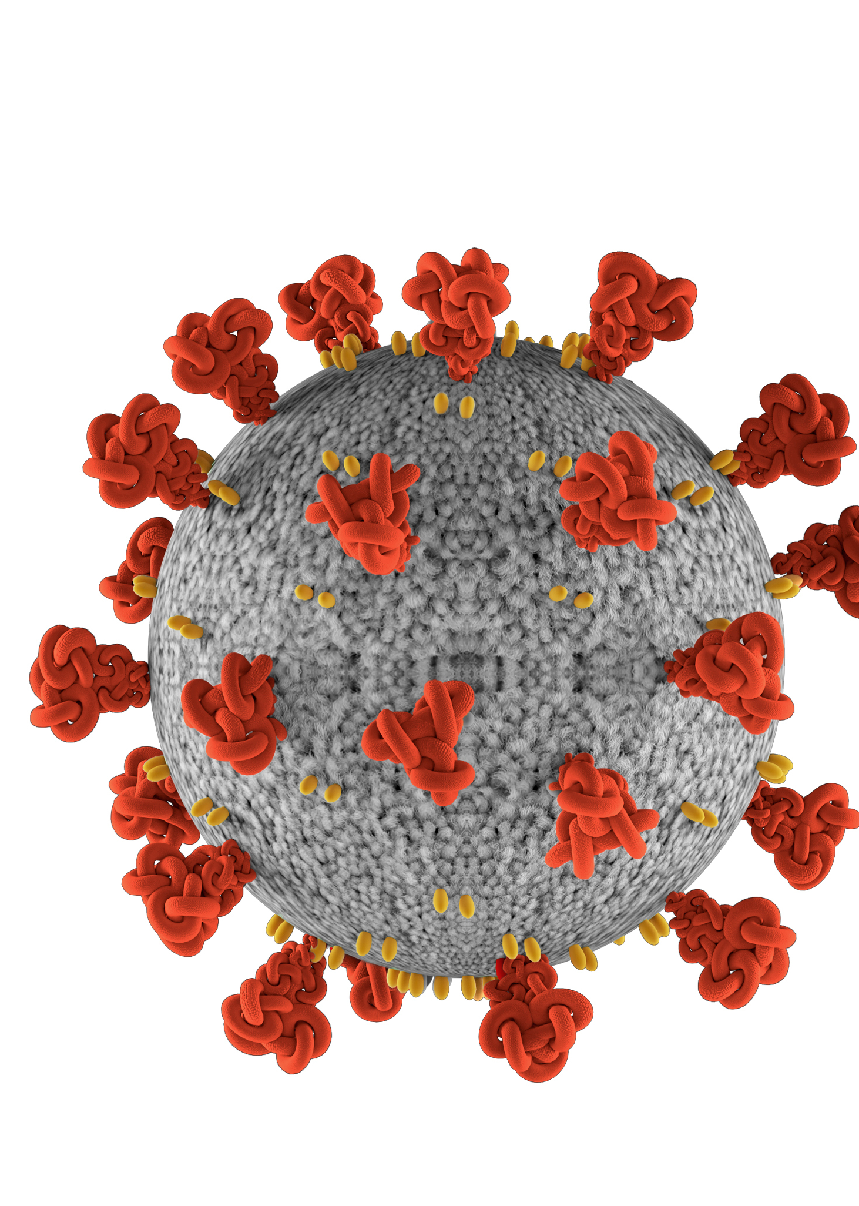
FORECASTING CASE COUNTS USING REGRESSION MODELS AND AN ANALYSIS ON COVID-19 DATASET
Venkateshwaran Thamilselvan
019076783C

Slide 2
Problem statement
1. Rank the countries based on -
Current death count
Current confirmed case count
Current active case count
Current recovered case count
Case-Fatality-Ratio
Incidence rate
2. Finding the correlation between the confirmed case counts, recovered case counts and death counts worldwide and for specific counties.
3. Creating machine learning models
Creating random forest regression model with the whole data and predict the confirmed cases for a particular location (using latitude and longitude) at a particular date.
Creating the random forest regression model for the US specific data (using the US specific records in John Hopkins university data) and to predict the confirmed cases on a particular location in a state of the country.

Slide 3
Problem statement Contd.
4. Visualization of the trends-
Plot the worldwide trend of confirmed, recovered and death counts as a line chart.
Plot the trends of confirmed, recovered and death counts as a line chart separately for each country.
5. Forecasting the confirmed case count and recovery case count using the linear regression model for Luxembourg for future dates and plotting it as a line chart.
6. Using the Mobility dataset to find the correlation between the confirmed case and mobility dataset features

Slide 4
Approach
Used Scala as a frontend language for Spark.
Used ML for creating regression models.
Used MLlib for getting the statistics of the data.
Used Scalaplot library to plot the line charts.
spark-shell --packages="org.sameersingh.scalaplot:scalaplot:0.0.4"
Used Spark SQL is used to perform queries and filter our data.
Used Spark SQL-Dataframe and RDD to store our data in the distributed manner.

Slide 5
Implementation

Slide 6
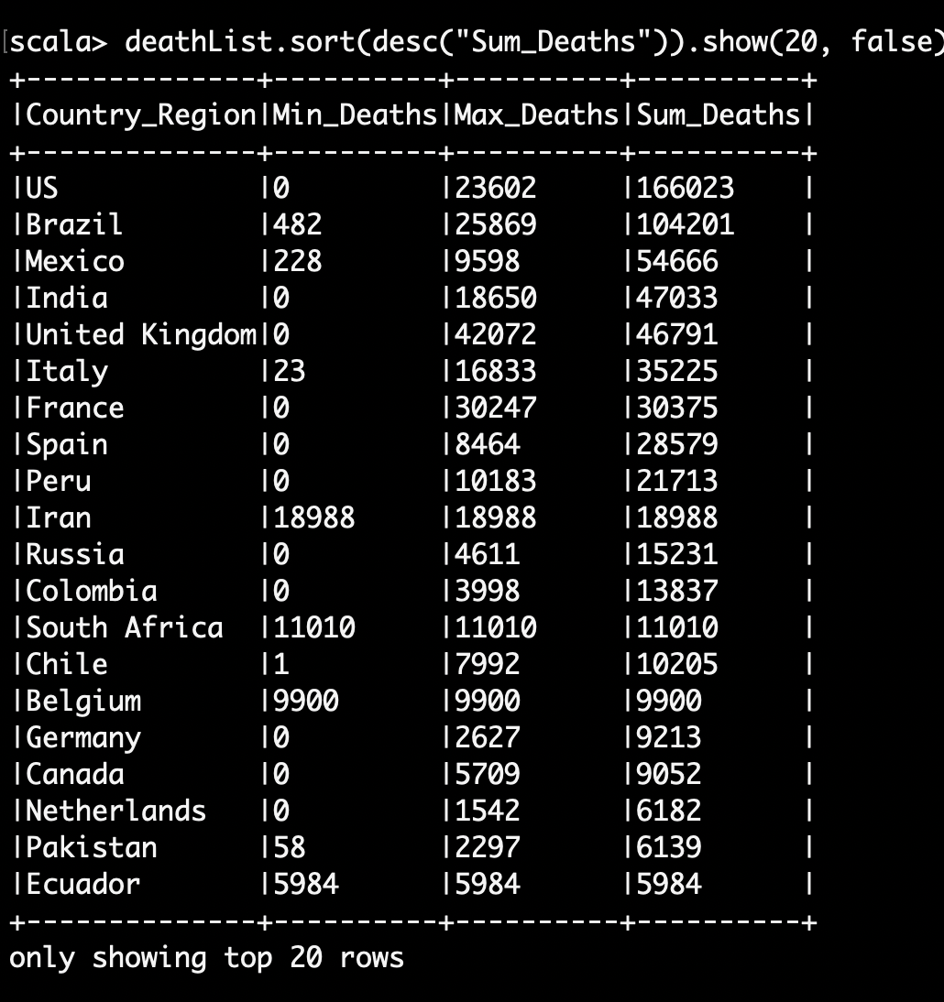
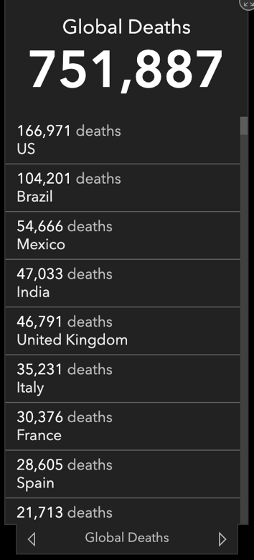
Evaluation and results
1 a. Ranking based on Death count

Slide 7
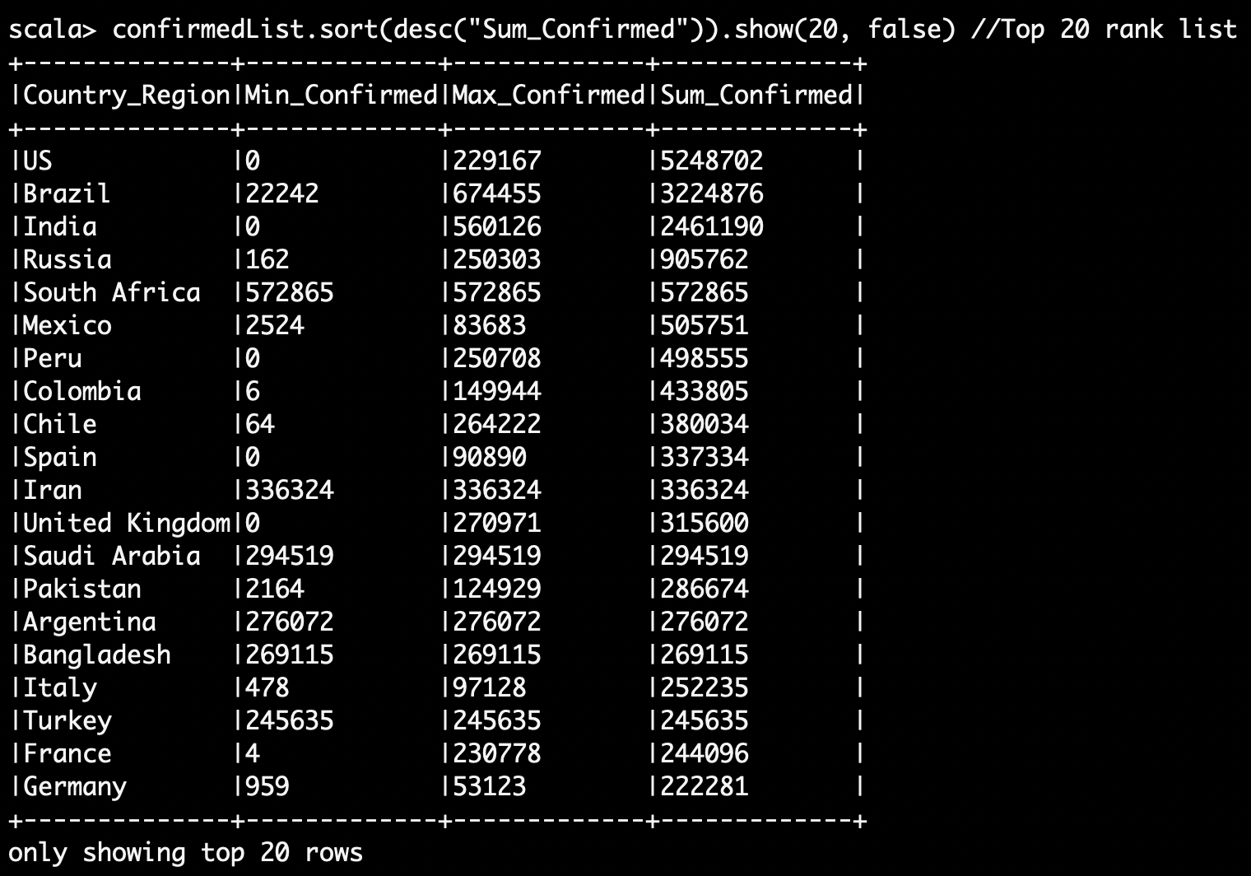
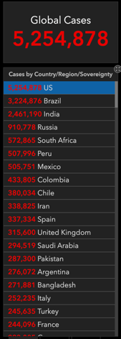
Evaluation and results Contd.
1 b. Ranking based on confirmed cases

Slide 8
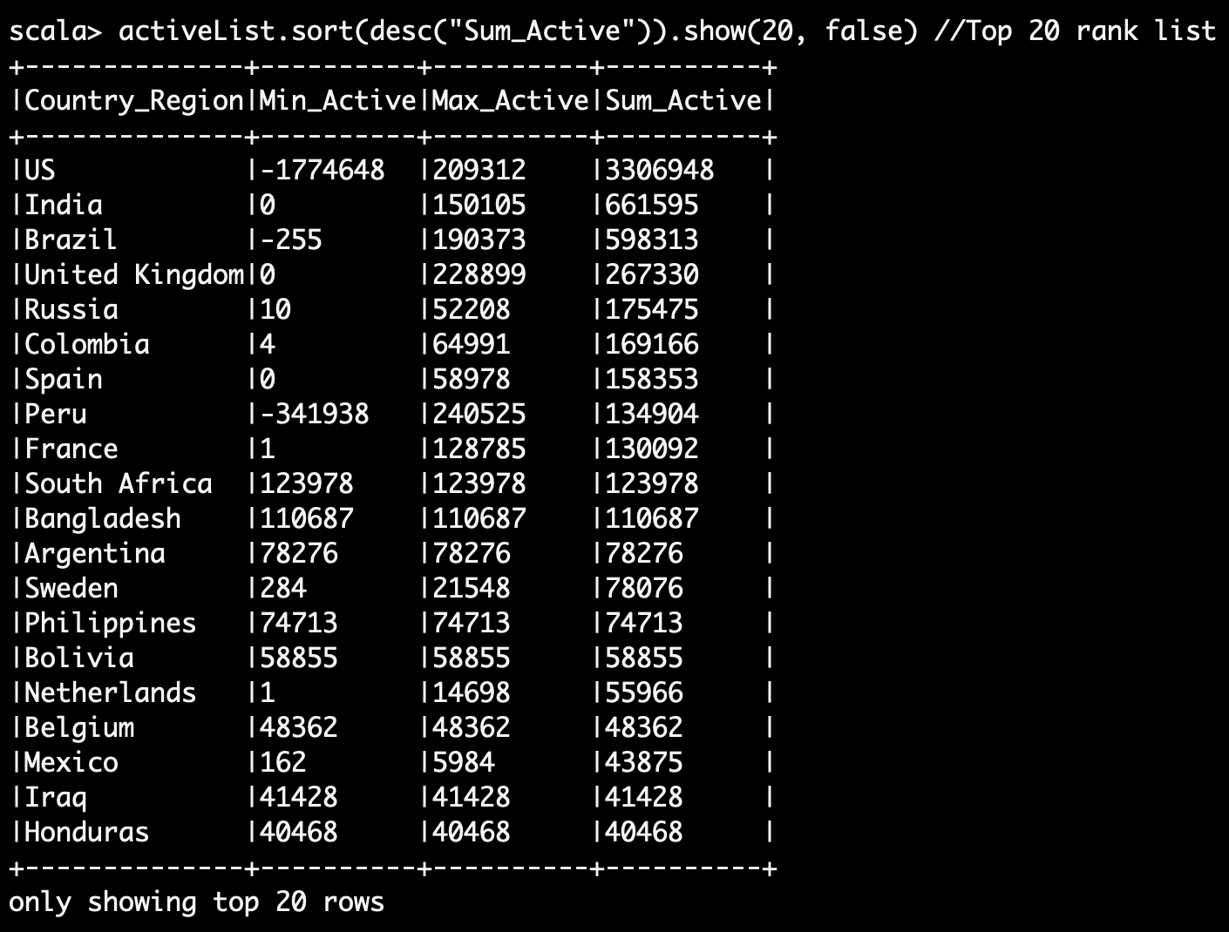
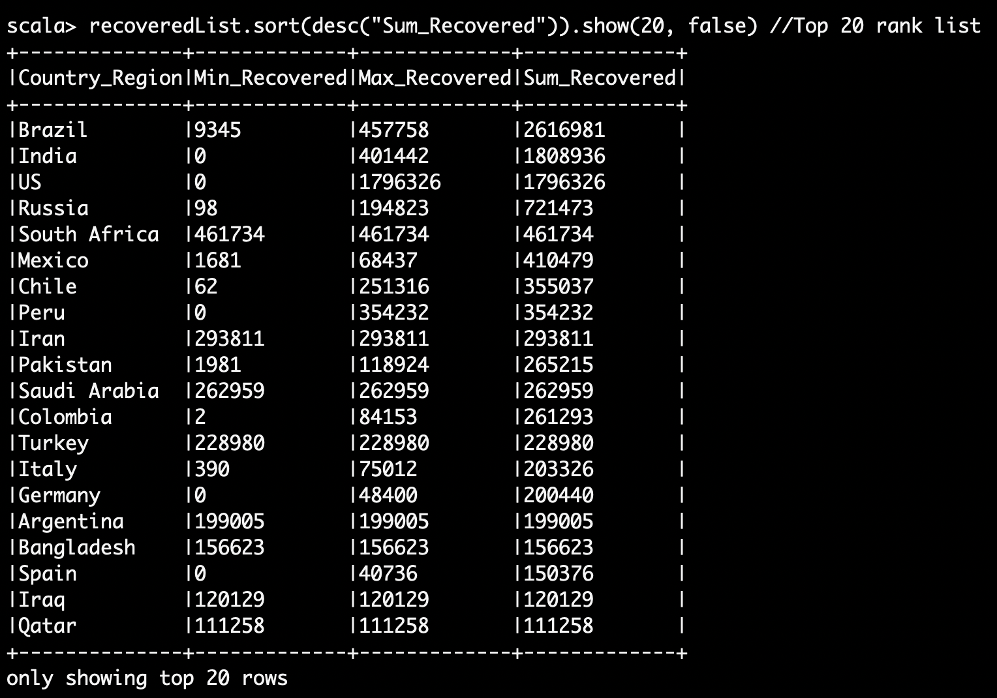
Evaluation and results Contd.
1 c. Ranking based on Active cases
1 d. Ranking based on Recovered cases

Slide 9
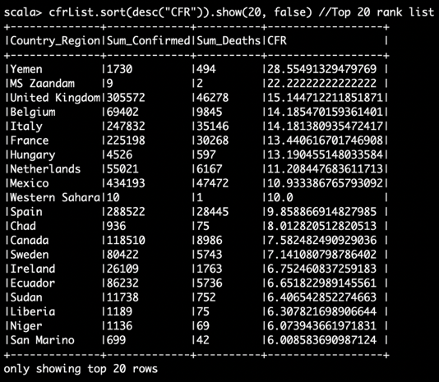
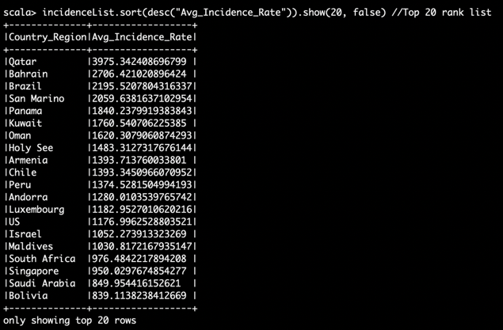
Evaluation and results Contd.
1 e. Ranking based on CFR
1 f. Ranking based on IR

Slide 10
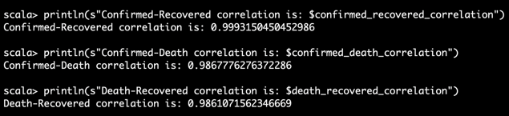
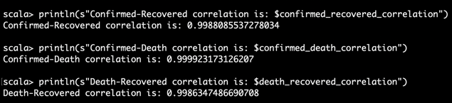
Evaluation and results Contd.
2. Correlation of Confirmed-Recovered-Death
For luxembourg:
Worldwide:

Slide 11
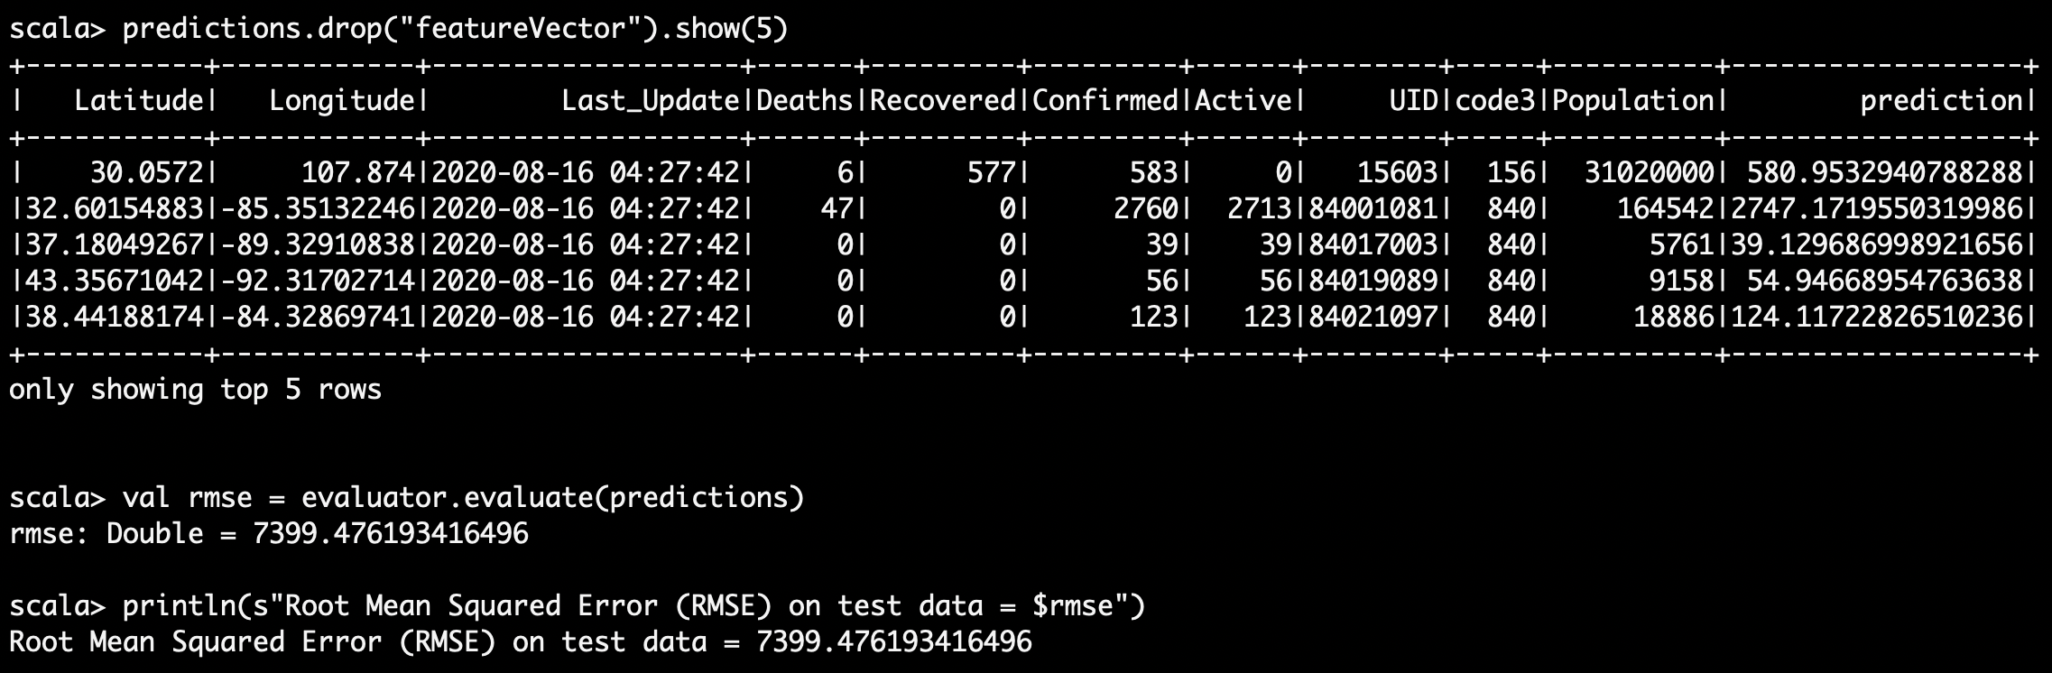
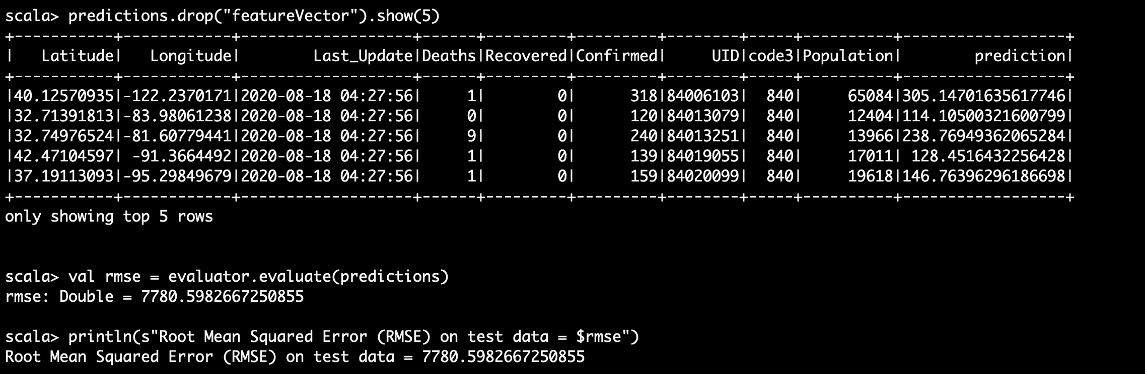
Evaluation and results Contd.
3. Predicting confirmed cases
Worldwide
US

Slide 12
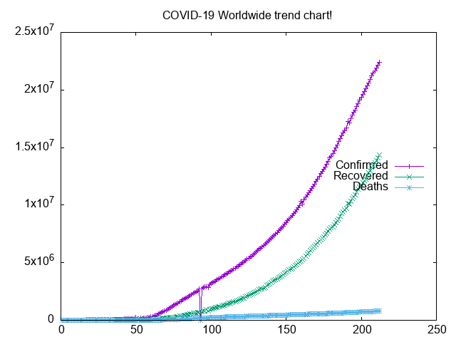
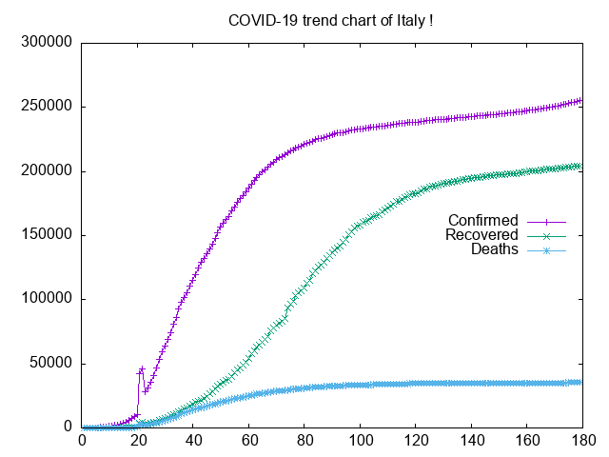
Evaluation and results Contd.
4. Trend charts

Slide 13
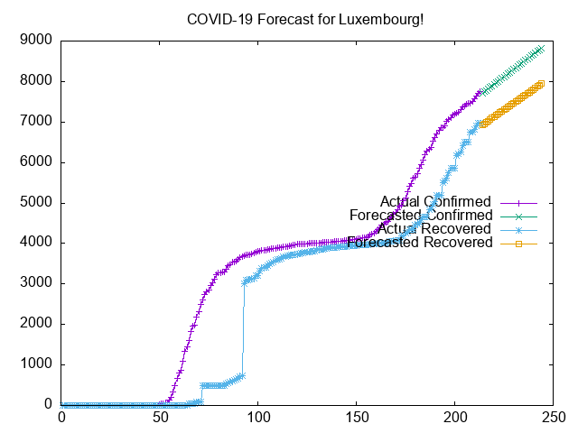
Evaluation and results Contd.
5. Forecast for Luxembourg using linear regression

Slide 14
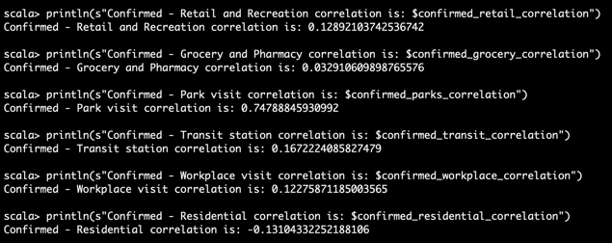
Evaluation and results Contd.
6. Correlation of confirmed cases and mobility data

Slide 15
Conclusions & Lessons Learned
How we can utilize the public dataset and implement nuances of bigdata.
How to implement the machine learning algorithms to study the dynamics of a pandemic.
How to distribute the data and perform a distributed computation which reduces the computation time greatly.
Different datatypes and nuances of a purely scalable language Scala

Slide 16


Thank you

